Slide 1


Stop reinventing the wheel with Istio
Mete Atamel
Developer Advocate at Google @meteatamel
Confidential & Proprietary

Slide 2

The need for Istio
Containers, Kubernetes

Slide 3
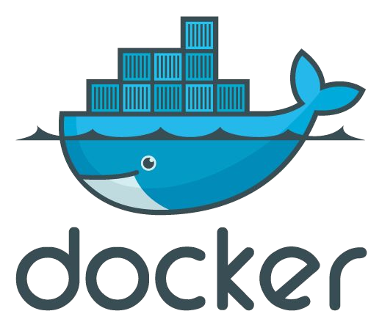
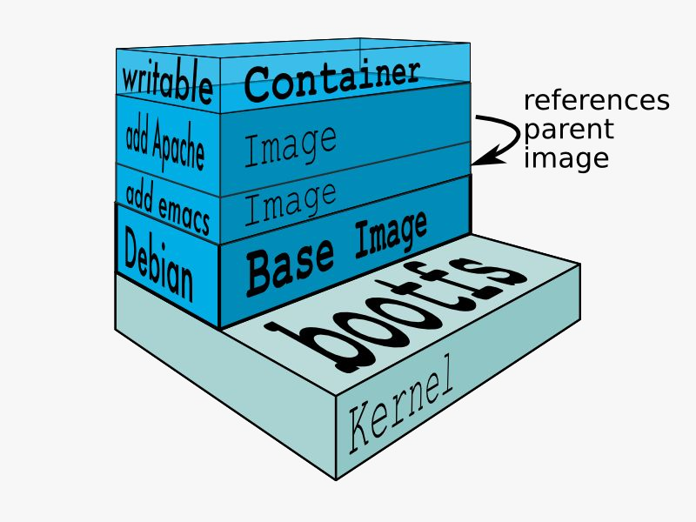
What is a container?
A lightweight way to virtualize applications
Linux (or Windows) processes
Lightweight Hermetically sealed Isolated
Easily deployable Introspectable Composable
Confidential & Proprietary

Slide 4
Docker: Tooling for the masses
Docker is a container runtime and image format
Dockerfile defines the dependencies, environment and the code to run
Container is a consistent invocation of a Dockerfile
FROM debian:latest
RUN apt-get update
RUN apt-get install -y nginx
CMD [“nginx”,”-g”,”daemon off;”] EXPOSE 80
5

Slide 5
Containers are not enough
Scaling up & down
Resiliency
Scheduling
Health Checks
Rolling out & back
Redundancy
Service Discovery
Config & Secrets
Confidential & Proprietary

Slide 6
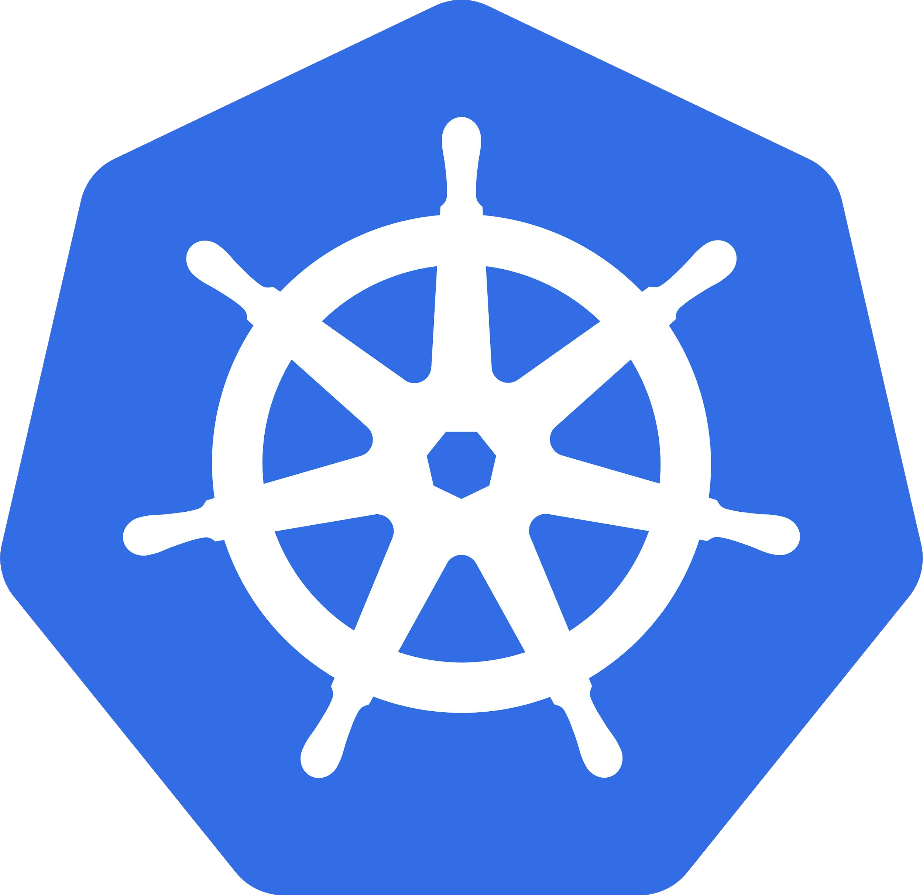
Kubernetes
Κυβερνήτης means “governor” in Greek
Manages container clusters
Inspired and informed by Google’s internal container system called Borg
Supports multiple cloud and bare-metal environments
100% Open source, written in Go
Manage applications, not machines
Confidential & Proprietary

Slide 7











Microservices in Kubernetes world
microservice
Replication controller
Service communication channel
Replicas: 3
Role: frontend
Env: prod
labels
Service
Blueprint “pod template”
Pods
Each pod containers one or more containers
Role: frontend
Role: frontend
Role: frontend
Env: prod
Env: prod
Env: prod
registry
containers
Nodes
Confidential & Proprietary

Slide 8
Kubernetes is not enough either
Service Identity & Auth
Logging
Metrics
Traffic Flow & Policies
Circuit Breaking
Fault Injection
Tracing
Dependency Visualisation
Failover
Confidential & Proprietary

Slide 9



Slide 10
Ιστιο means “sail” in Greek
Istio: An open framework for connecting, securing, managing and monitoring services

Slide 11











Service architecture without Istio
frontend
auth
Users
Cloud SQL
External Payment Processor
pictures
payments
Confidential & Proprietary

Slide 12






Service architecture with Istio
frontend
auth
Users
Cloud SQL
public ingress
proxy
proxy
egress
proxy
proxy
private ingress
External Payment Processor
pictures
payments
Confidential & Proprietary

Slide 13

Istio in a single slide
Platform support: Kubernetes (Nomad, Mesos, Cloud Foundry)
Current version: 1.4.6
Observability: Metrics, metrics query/visualization, trace spans, dependency visualisation
Service Identity & Security: Verifiable service identity, mutual auth
Traffic Management:
Dynamic traffic control
Ingress/egress routing
Timeouts, retries and fault injection
Policy enforcement and quote management
Confidential & Proprietary

Slide 14
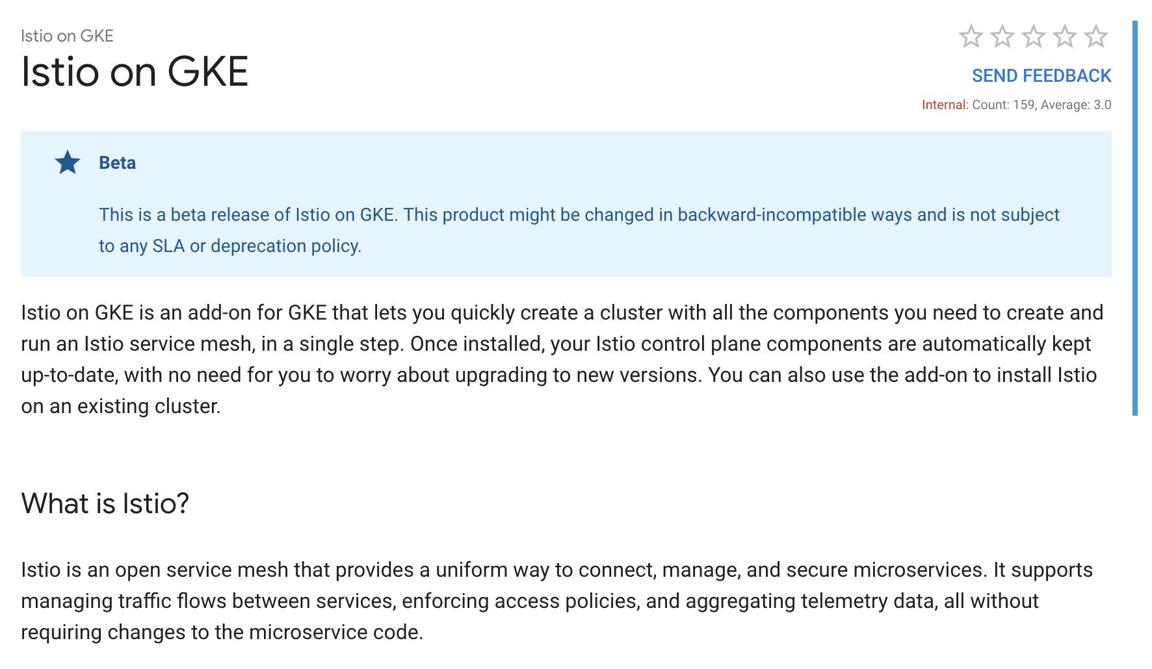

Confidential & Proprietary

Slide 15
$ gcloud beta container clusters create istio-demo \
--addons=Istio --istio-config=auth=MTLS_STRICT \
--cluster-version=latest \
--machine-type=n1-standard-2 \
--num-nodes=4
Creating cluster istio-demo in europe-west4-a Created[https://container.googleapis.com/v1beta1/projects/istio-project2517/zones/europe-west4-a/clus ters/istio-demo]
NAME LOCATION MASTER_VERSION MASTER_IP MACHINE_TYPE NODE_VERSION NUM_NODES STATUS
istio-demo europe-west4-a 1.12.5-gke.5 35.204.5.121 n1-standard-2 1.12.5-gke.5 4 RUNNING
$ kubectl create clusterrolebinding cluster-admin-binding \
--clusterrole=cluster-admin \
--user=$(gcloud config get-value core/account)
clusterrolebinding "cluster-admin-binding" created
16

Slide 16


Building Blocks
Envoy, Mixer, Pilot, Citadel

Slide 17




Istio Architecture
frontend
payments
Traffic transparently proxied — unaware of Envoy sidecars
HTTP/1.1, HTTP/2, gRPC with
or without TLS
proxy
proxy
Discovery & config data to Envoy sidecars
Policy checks, telemetry
TLS certs
to Envoy sidecars
Pilot
Mixer
Citadel
Control Plane
Confidential & Proprietary

Slide 18
Demo: Deploy App
Confidential & Proprietary

Slide 19

Routing API

Slide 20
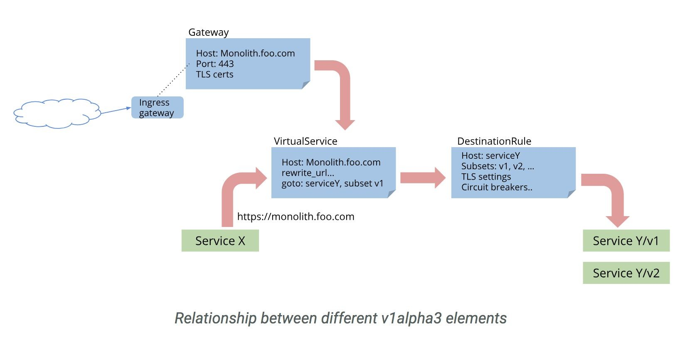
Istio Routing
Confidential & Proprietary

Slide 21

Add-ons
Prometheus, Grafana, Jaeger/Zipkin, ServiceGraph

Slide 22
Install Prometheus
$ curl
https://storage.googleapis.com/gke-release/istio/release/1.0.3-gke.3/patches/instal l-prometheus.yaml | kubectl apply -n istio-system -f -
service "prometheus" created deployment.extensions "prometheus" created
$ kubectl get svc prometheus -n istio-system
NAME AGE
prometheus
TYPE CLUSTER-IP EXTERNAL-IP
ClusterIP 10.31.250.92 <none>
PORT(S)
9090/TCP
Confidential & Propriet
ary

Slide 23
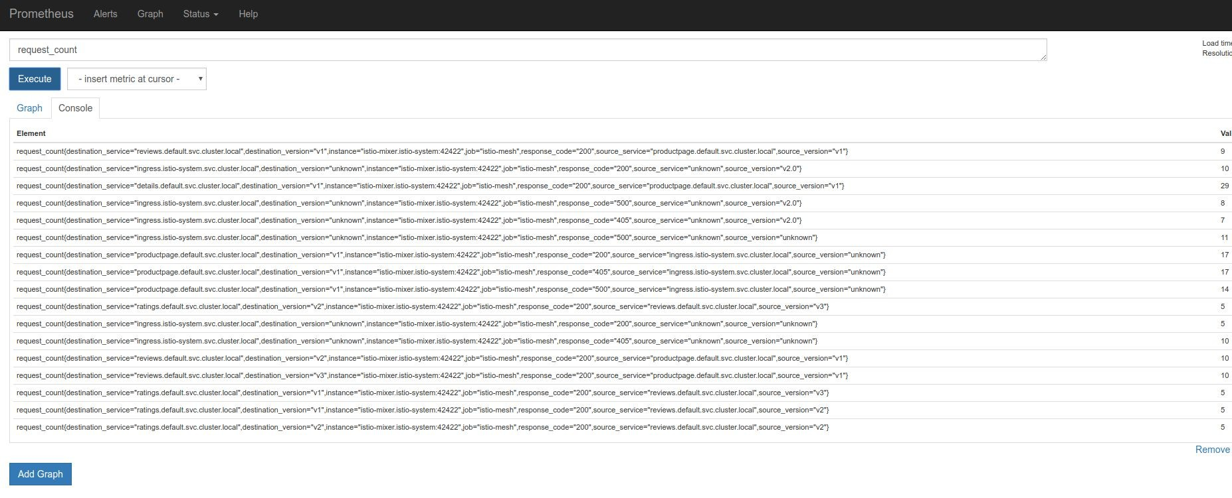
Prometheus: Query metrics
Confidential & Proprietary

Slide 24
Install Grafana
$ curl
https://storage.googleapis.com/gke-release/istio/release/1.0.3-gke.3/patches/instal l-grafana.yaml | kubectl apply -n istio-system -f -
service "grafana" created deployment.extensions "grafana" created
$ kubectl get svc grafana -n istio-system
NAME AGE
grafana
TYPE CLUSTER-IP EXTERNAL-IP
ClusterIP 10.31.251.158 <none>
PORT(S)
3000/TCP
Confidential & Propriet
ary

Slide 25
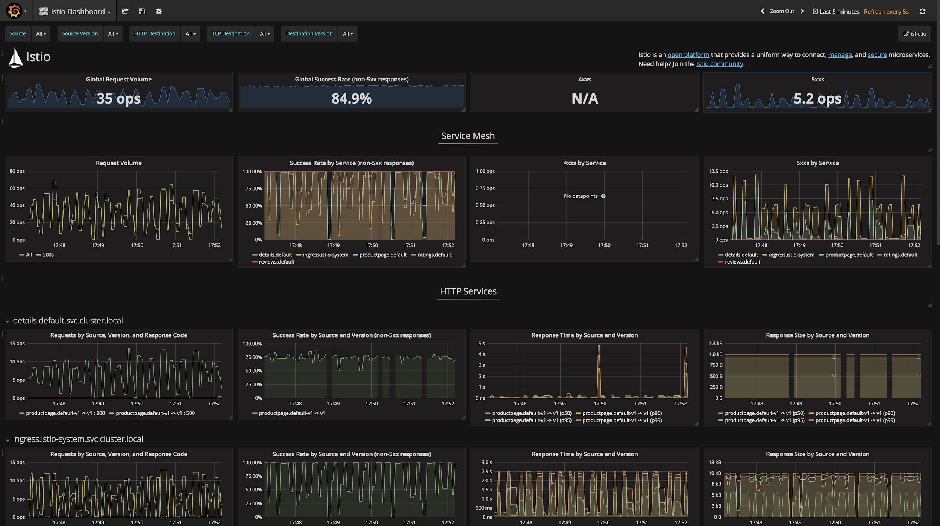
Grafana: Visualize metrics
Confidential & Proprietary

Slide 26
Install ServiceGraph
$ curl
https://storage.googleapis.com/gke-release/istio/release/1.0.3-gke.3/patches/instal l-servicegraph.yaml | kubectl apply -n istio-system -f -
service "servicegraph" created deployment.extensions "servicegraph" created
$ kubectl get svc servicegraph -n istio-system
NAME | TYPE | CLUSTER-IP | EXTERNAL-IP | PORT(S)
servicegraph | ClusterIP | 10.31.251.158 | <none> | 8088/TCP
Confidential & Propriet
ary

Slide 27
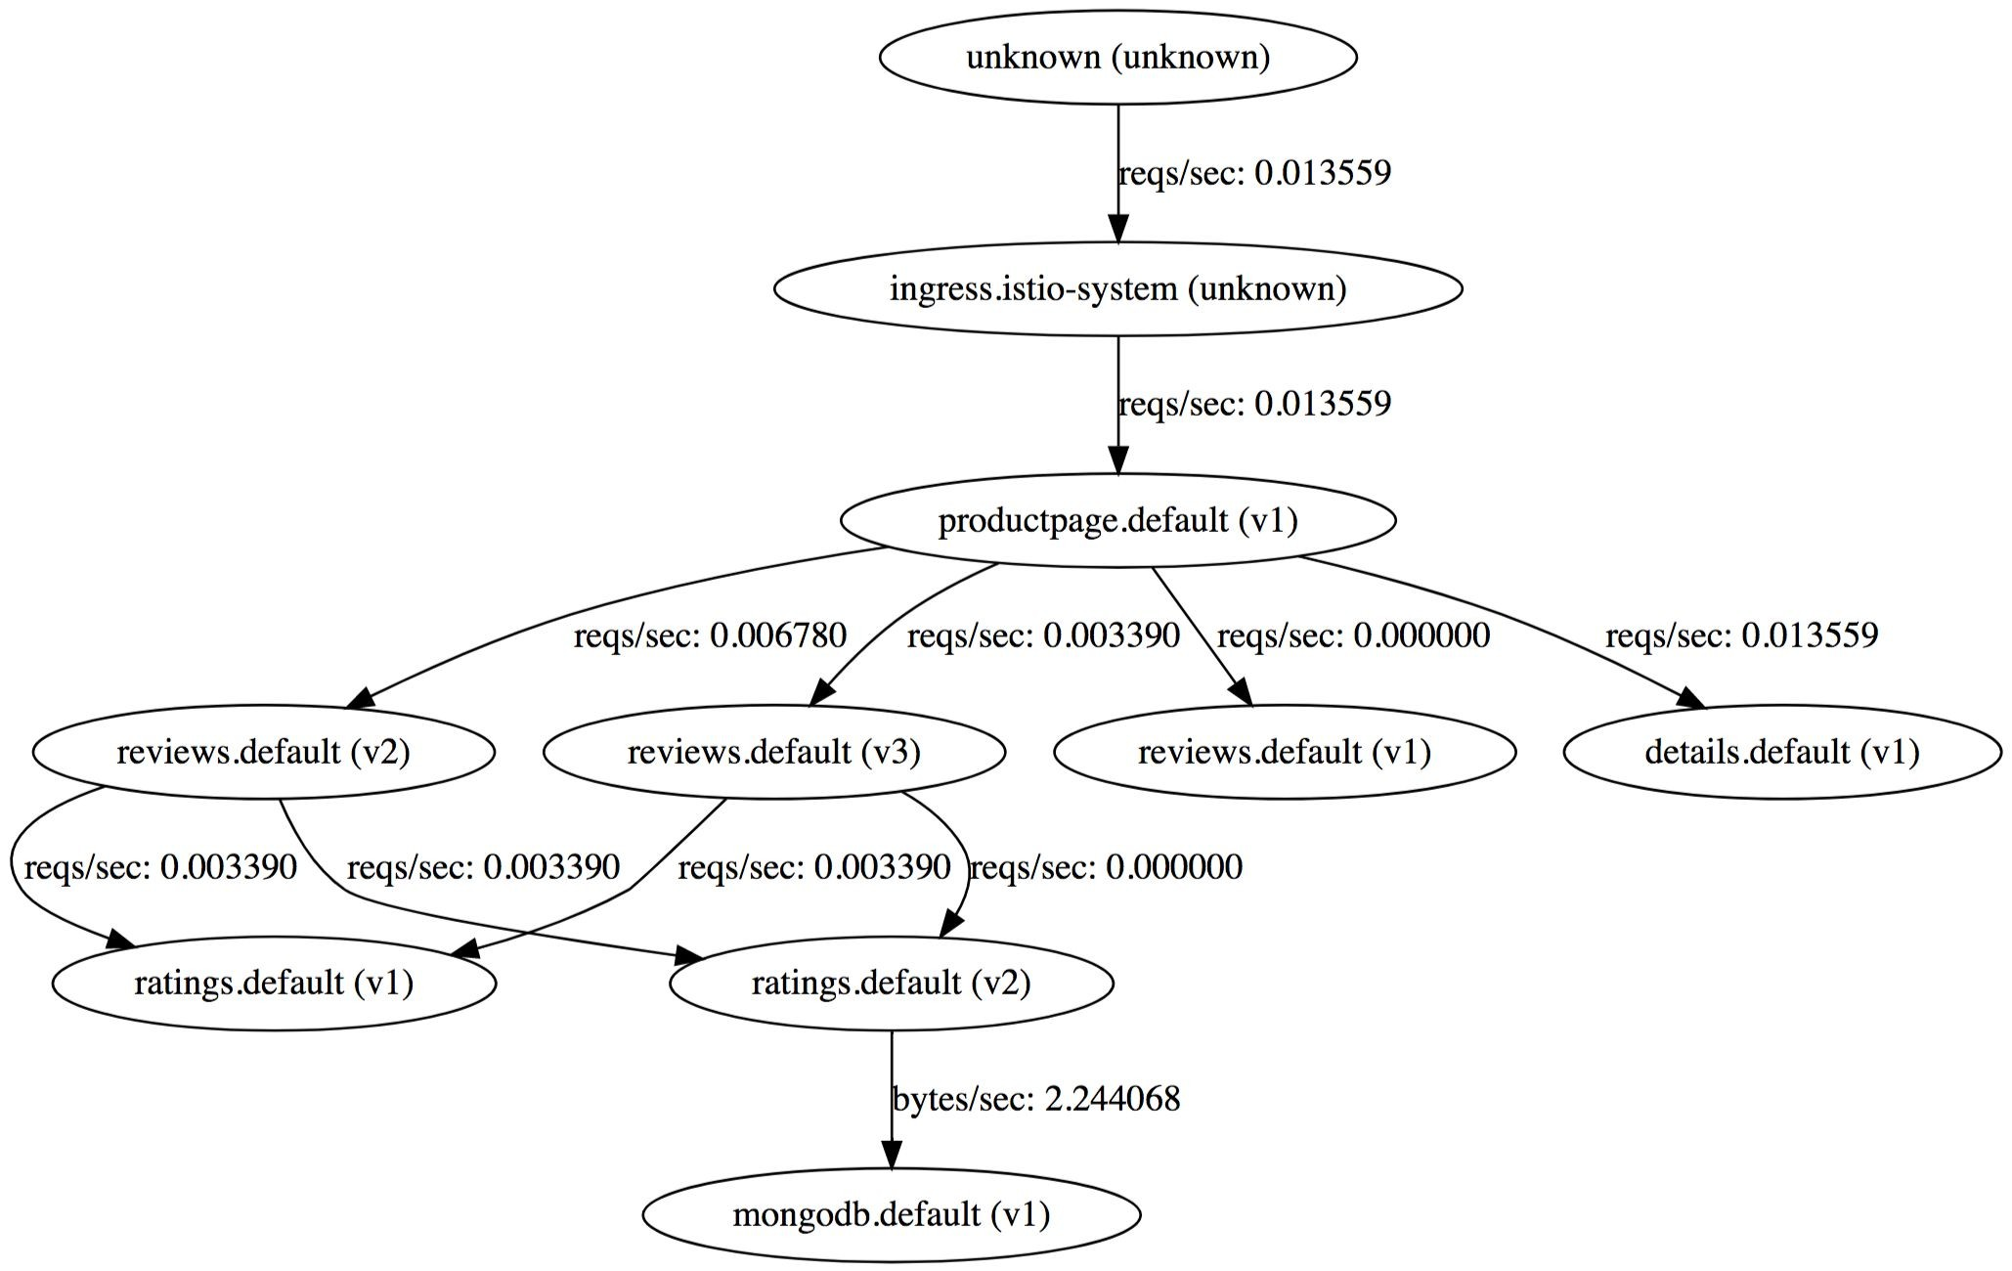
ServiceGraph
Confidential & Propr
ietary

Slide 28
Install Tracing (Jaeger, Zipkin)
$ curl
https://storage.googleapis.com/gke-release/istio/release/1.0.3-gke.3/patches/instal l-tracing.yaml | kubectl apply -n istio-system -f -
service "jaeger-query" created service "jaeger-collector" created service "jaeger-agent" created service "zipkin" created
service "tracing" created
$ kubectl get svc jaeger-query -n istio-system
NAME TYPE
jaeger-query ClusterIP
CLUSTER-IP EXTERNAL-IP 10.31.251.158 <none>
PORT(S) 16686/TCP
Confidential & Propriet
ary

Slide 29
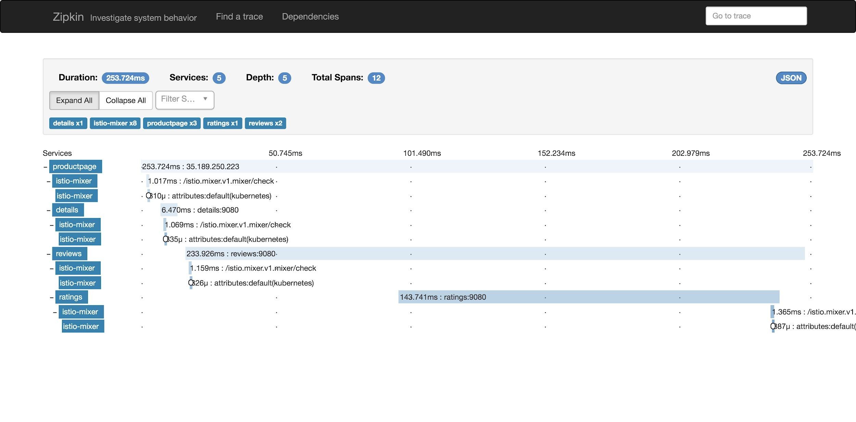
Jaeger/Zipkin: Tracing
Confidential & Proprietary

Slide 30
Demo: Show add-ons
Confidential & Proprietary

Slide 31

Traffic Management
Request Routing, Discovery & Load Balancing, Failure Recovery, Fault Injection

Slide 32
Traffic Management
Istio’s traffic management decouples traffic flow from infrastructure
Discovery & load balancing across services
Dynamic request routing for A/B testing, gradual rollouts, canary releases
Failure recovery using timeouts, retries, and circuit breakers
Fault injection to test the compatibility of recovery policies across services
Confidential & Proprietary

Slide 33
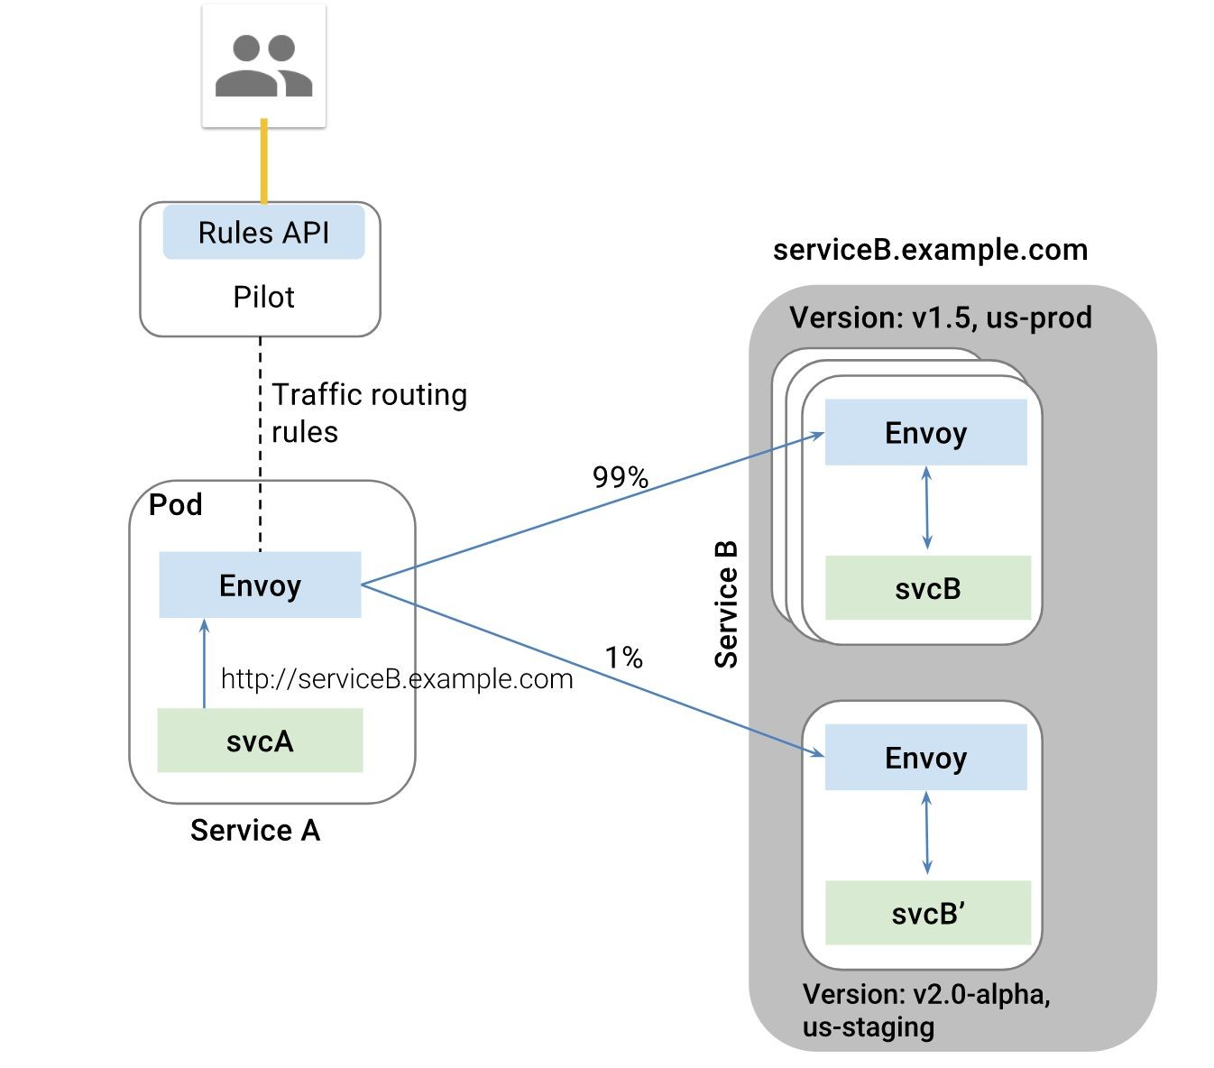
Request Routing
Confidential & Proprietary

Slide 34
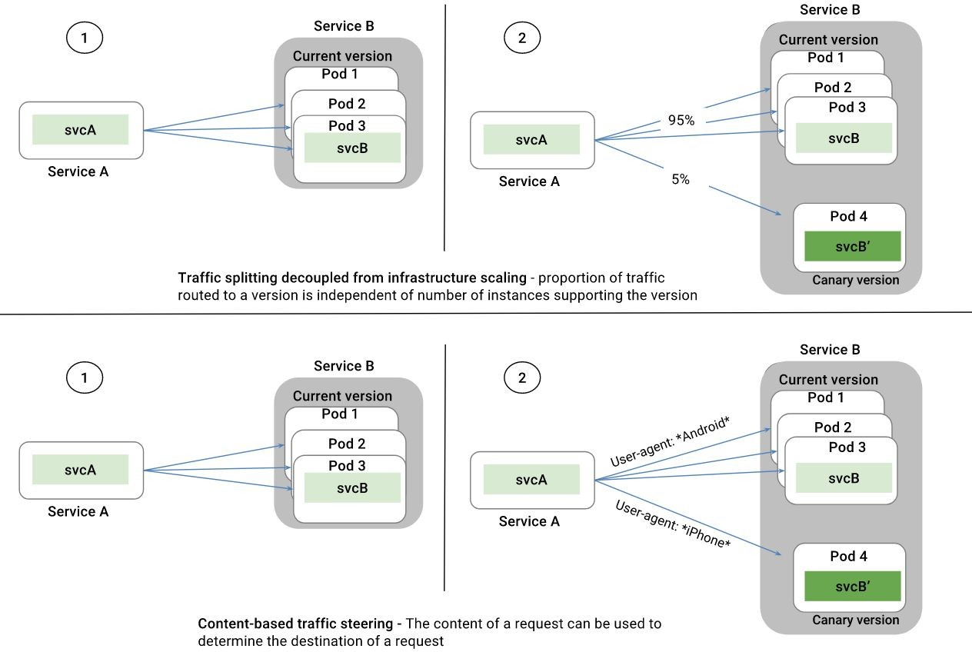

Slide 35
Failure Handling
Out-of-the-box opt-in failure recovery features such as:
Default timeout for HTTP requests is 15 seconds but configurable
The number of retries for a given HTTP request
Limits on number of concurrent connections
Circuit breakers can be set based on a number of criteria such as connection and request limits
Confidential & Proprietary

Slide 36
Fault Injection
The faults can be either delays or aborts. Examples:
5 second delay in 10% of the requests to the “v1” version of the service
Return HTTP 400 error for 10% of the requests to the service “v1”
300ms
400ms
frontend
movies
stars
proxy
proxy
proxy
timeout: 100ms retries: 3
timeout: 200ms retries: 2
Confidential & Proprietary

Slide 37
Demo: Traffic Management
Confidential & Proprietary

Slide 38
Thank you!
Mete Atamel
@meteatamel
https://codelabs.developers.google.com/codelabs/cloud-istio-aspnetcore-part1 https://codelabs.developers.google.com/codelabs/cloud-istio-aspnetcore-part2
@istiomesh
istio-users@googlegroups.com
Confidential & Proprietary

